Slide 1
DEMOCRACY PROJECT 2021-2022
Speak Young Americans: How can you serve your community
as a participating citizen in a democracy?

Slide 2
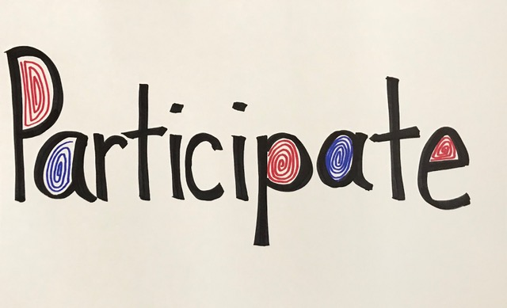

Slide 3
What is democracy?
Basic political principles of our democracy:
Human beings are born free and equal.
The power of government rests on the consent of the governed.
Government is measured by how it protects the individual and her/his rights.
There exists an ongoing tension, and therefore a political debate, in assessing when the proper limits on the power of government are transgressed.
What are some advantages of living in a democracy?
What are some dangers if you do not live in a democracy?
How can we protect our democracy?

Slide 4
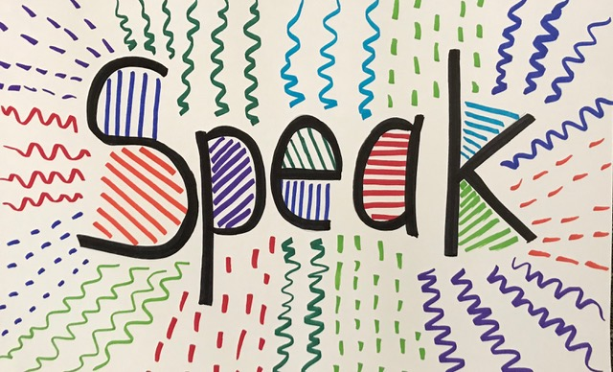

Slide 5
Practicing Democracy Responsibly
What does the US Constitution say about the relationship of the US government to religion?
What does the US Constitution say about speech? How is it protected?
What does the US Constitution say about a free press?
Congress shall make no law respecting an establishment of religion, or prohibiting the free exercise thereof; or abridging the freedom of speech, or of the press; or the right of the people peaceably to assemble, and to petition the Government for a redress of grievances.
U.S. Constitution. Amendment I

Slide 6
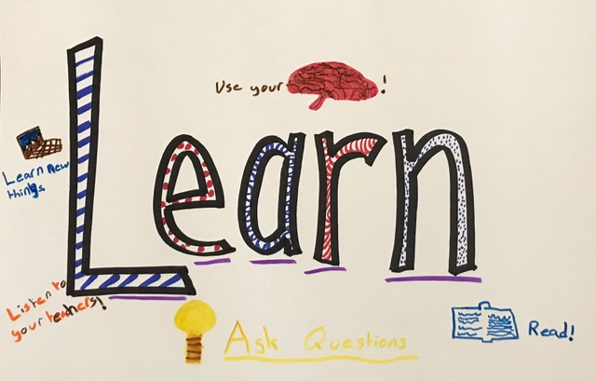

Slide 7
January 8, 1790, George Washington delivered the first State of the Union address in New York City which was the U.S. capital at the time. He spoke before the Senate and House of Representatives. He concluded the speech with the following words:
… The welfare of our country is the great object to which our cares and efforts ought to be directed, and I shall derive great satisfaction from a cooperation with you in the pleasing though arduous task of insuring to our fellow citizens the blessings which they have a right to expect from a free, efficient, and equal government.

Slide 8
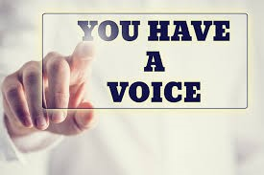
IMAGINE THAT YOU ARE A POLITICAL LEADER RIGHT NOW IN YOUR CITY, STATE OR COUNTRY: HOW WOULD YOU BEGIN TO ADDRESS THE PROBLEMS THAT CONFRONT YOUR CONSTITUENTS? HOW WOULD YOU ADDRESS DIVISIONS AMONG CITIZENS?

Slide 9
What do we mean by a “common civic identity”?
Civic identity is best understood in relation to three qualities: membership, rights, and participation.
What does “common civic duty” look like?
Civic duties include obeying the laws of the country, paying the taxes levied by the government, or serving on a jury or as a witness in court.
What does “civic responsibility” look like?
Civic responsibility denotes practices associated with being a productive citizen such as volunteering, voting, serving on boards, running for office, etc…

Slide 10
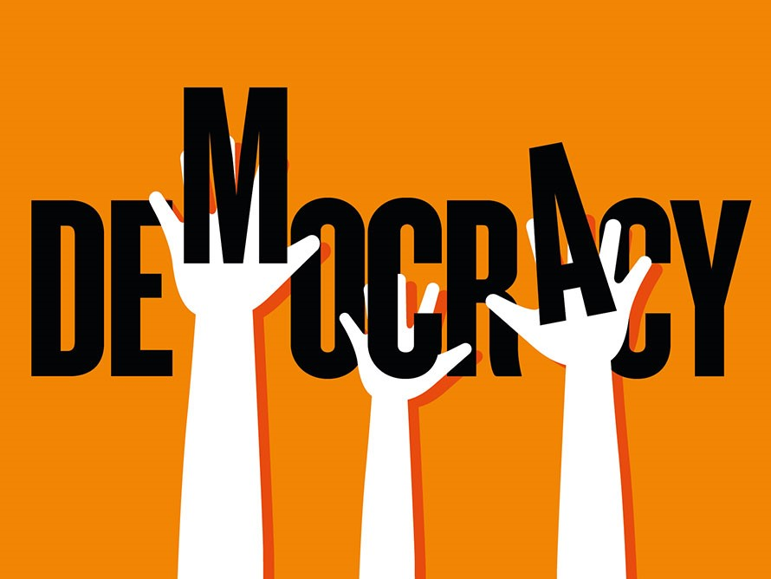

Slide 11
What do we mean by having “a common purpose” or a “common goal”?
How do you think about having a common purpose in your classroom?
In your school?
In your family?
On a sports team?
What would a common goal or purpose be for our city and county?
Our state?
Our country?
How do we create a bond between people?
How can we work together toward a common purpose?

Slide 12
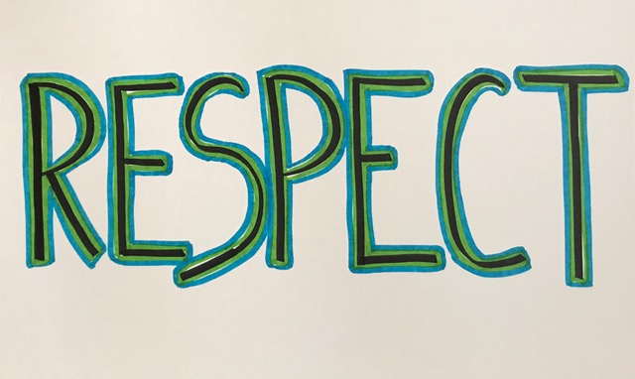

Slide 13
Practicing Democracy Responsibly
What does the US Constitution say about who has equal protection and rights?
All persons born or naturalized in the United States, and subject to the jurisdiction thereof, are citizens of the United States and of the State wherein they reside. No State shall make or enforce any law which shall abridge the privileges or immunities of citizens of the United States; nor shall any State deprive any person of life, liberty, or property, without due process of law; nor deny to any person within its jurisdiction the equal protection of the laws.
U.S. Constitution. Amendment XIV. Section I.

Slide 14
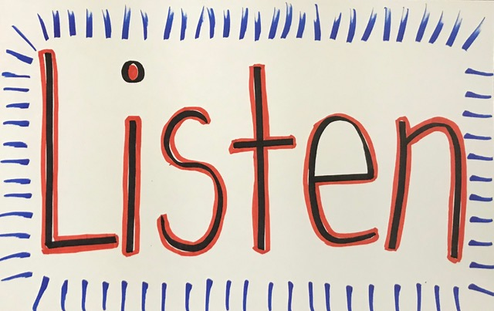

Slide 15
What is our shared story as Americans?
How does this story differ if you are Native American?
African American?
A new citizen who came as a refugee from war or other violence?
What do we all have in common?

Slide 16
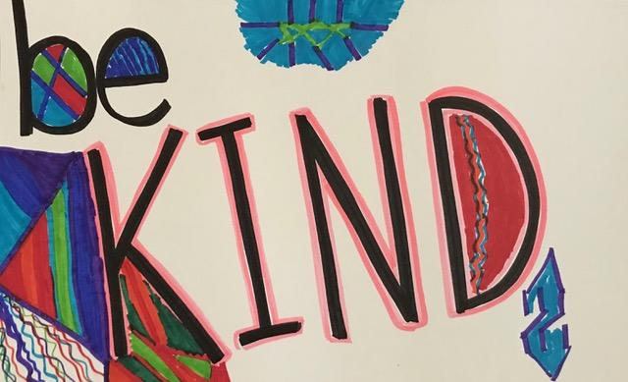

Slide 17
Why do our words matter?
How do you feel if someone calls you an insulting name?
Or makes fun of your looks, your clothes, your grades, your parents?
What would you do if your friends were doing this to someone else?
How can we practice respect for other people?

Slide 18
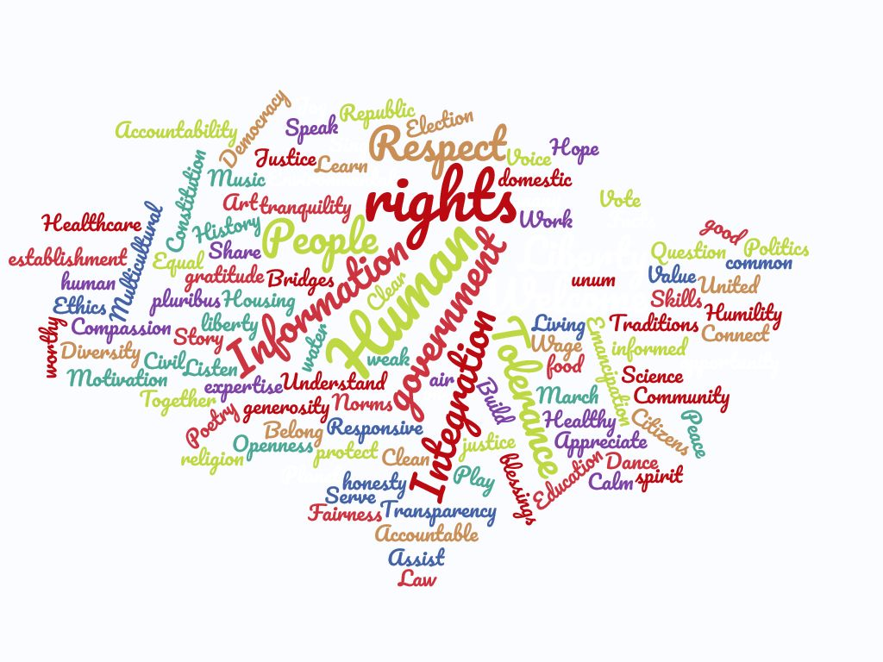

Slide 19
WHY DO FACTS MATTER?
You are entitled to your own opinion, but not to your own facts. Daniel Moynahan.
A popular student leader yells fire, but there is not an actual fire. What happens if there is a real fire after that?
What if you decide that the law of gravity is not real and to test your belief, you walk to the top of a tower and jump off? When you land, which will have mattered more…the fact of the law of gravity or your belief that it does not exist?
Where do we turn for factual information? Families? Teachers? Books? Internet sources? Radio? TV?
How can we learn more about the sources we turn to for information?
How can we verify the accuracy of the facts we find?
Who can help us with this?

Slide 20
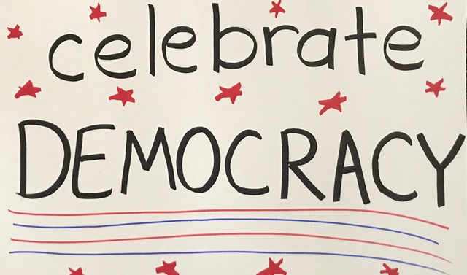

Slide 21
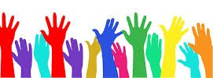
Government of the people, by the people, for the people, shall not perish from the Earth.
-Abraham Lincoln

Slide 22
AWARDS NIGHT. PORTER CENTER. MAY 2018

Slide 23
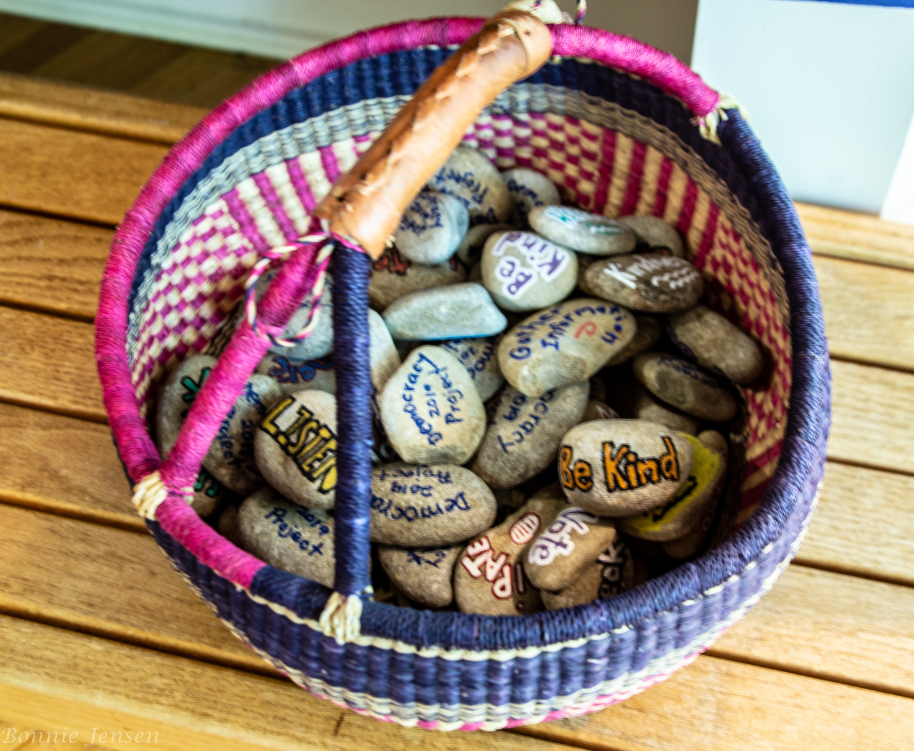
DEMOCRACY ROCKS!

Slide 24
WHAT DOES IT MEAN TO BE A GOOD CITIZEN?
How do we learn what our government is doing? How do we make our views heard?
Take time to be informed
See the problems we face for what they are. Evaluate fairly.
Vote in local, state, and national elections.
Duties: obey laws, pay taxes, serve a jury or as a witness in court when required.
Responsibilities: vote, volunteer, run for office, stay informed, serve on boards…
Study our country’s history and our stories, the foundations of our political system.
Learn the structures of government & how they function.
Reward leaders who demonstrate integrity & appeal to our better selves.
Choose leaders who care enough about truth to reject propaganda and lies.
Appreciate how the system works, accept its messiness & difficulty. Engage the system to focus on the problems that face us.
Show understanding & empathy for those who hold views different than your own.
Why is it vital to make space for different views in order to solve problems?
Why is it important to separate religion and politics & to protect religious minorities?
How do differing views make our approach to problem solving more effective?

Slide 25
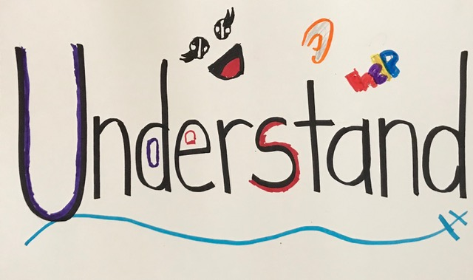

Slide 26
WHAT DOES IT MEAN TO BE A GOOD CITIZEN IN THE 21ST CENTURY?
What do you see as vital for our future as a community?
A country?
A world?
A planet?
What small step can you imagine that might be a start for people to work together toward that future goal?

Slide 27
The following are sample projects and scenes from 2021 awards ceremony.
2021 theme “Speak out young Americans: How can you make your voice count?”
For more projects from previous years,
visit Democracy Project Transylvania website
www.democracyprojectoftransylvania.org

Slide 28
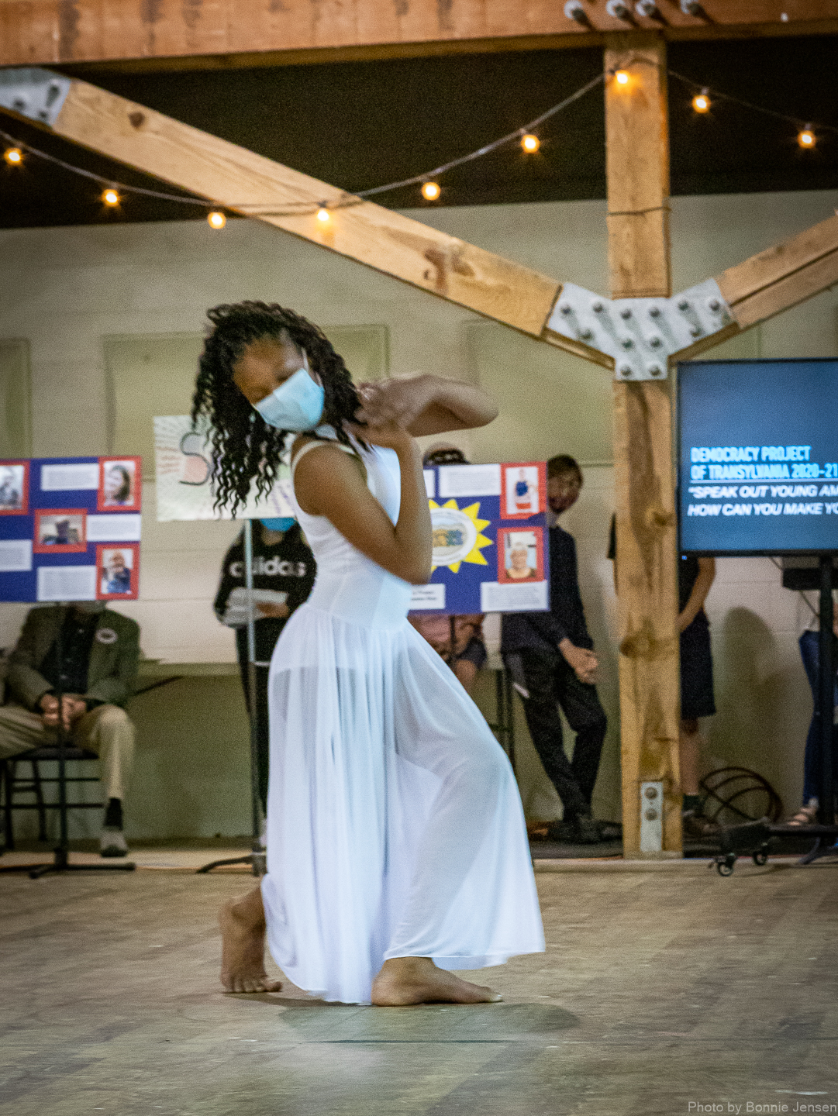

Slide 29
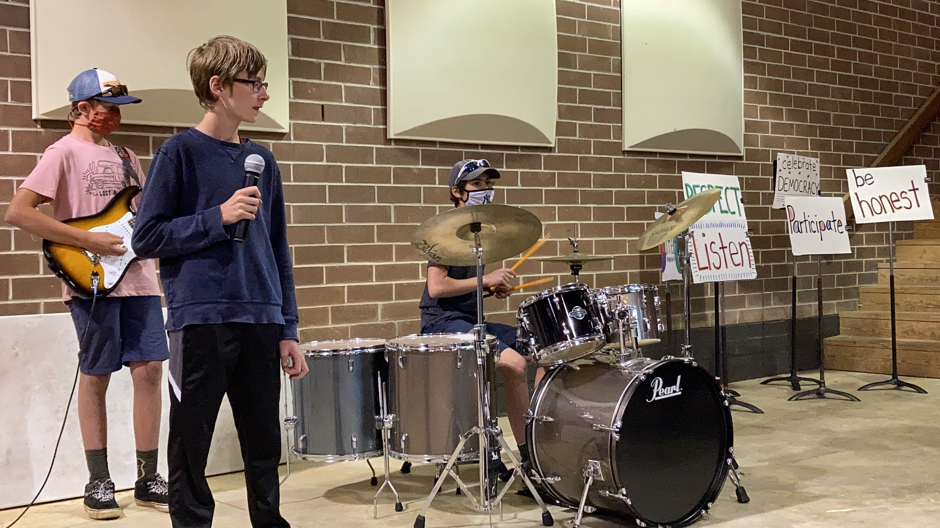

Slide 30
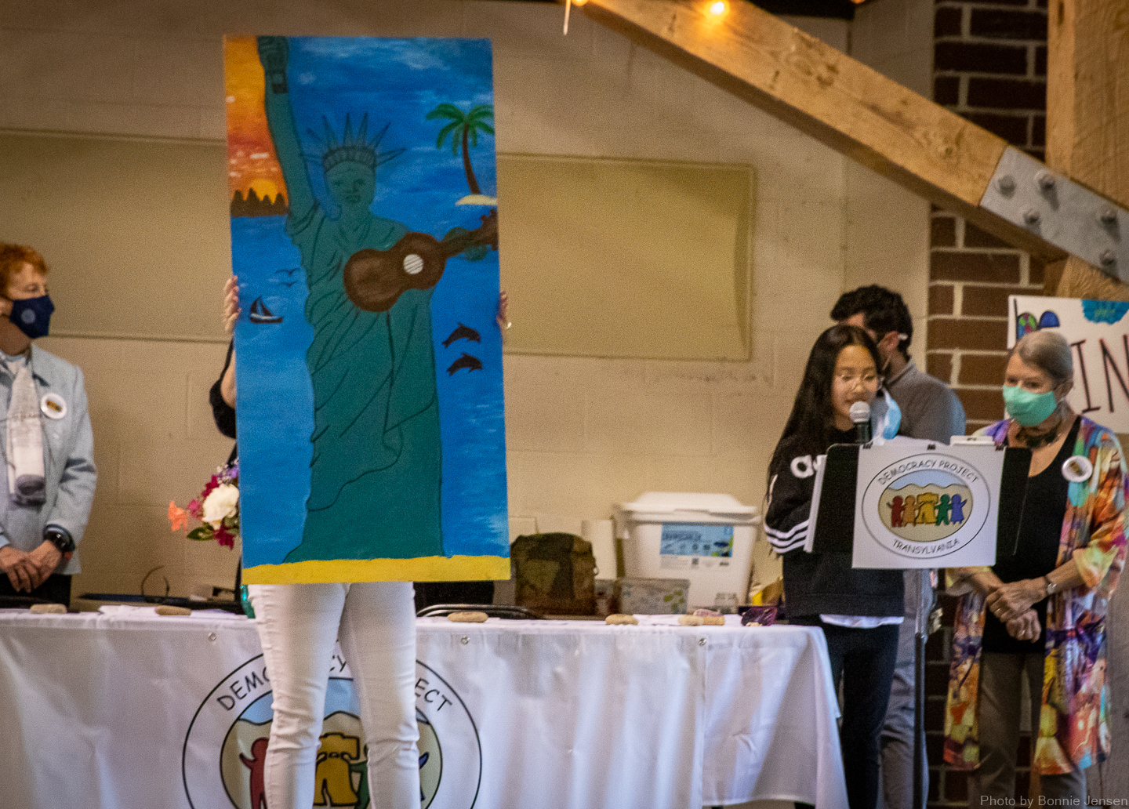

Slide 31
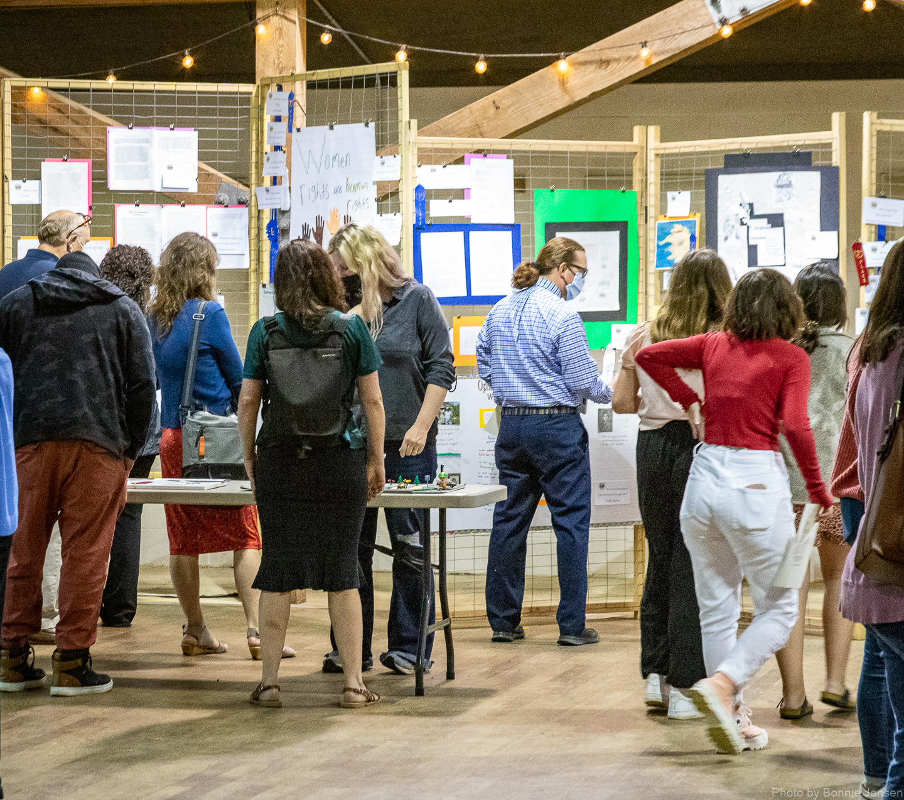

Slide 32
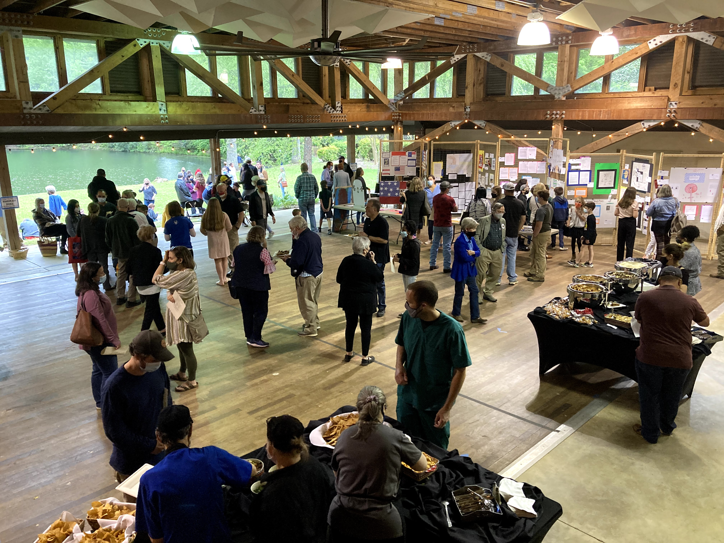

Slide 33
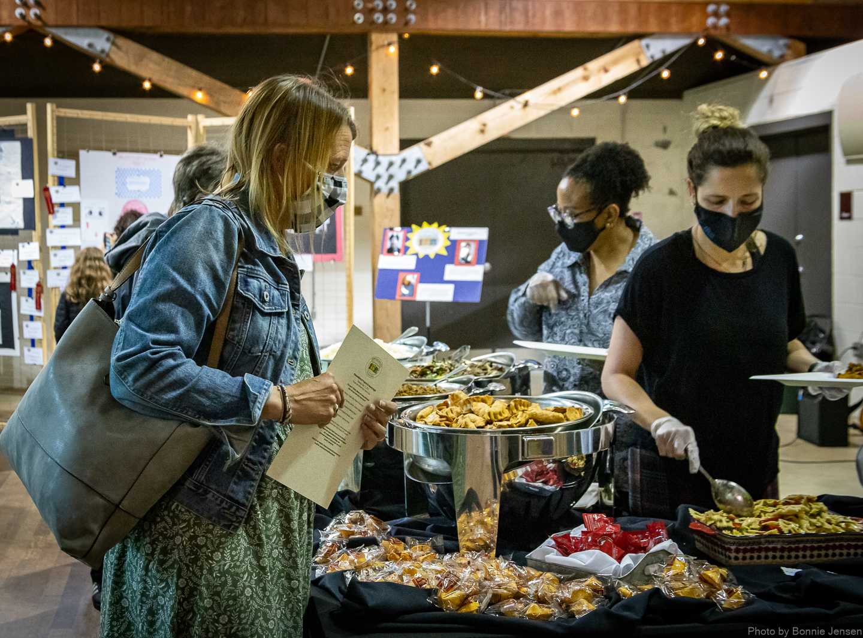

Slide 34
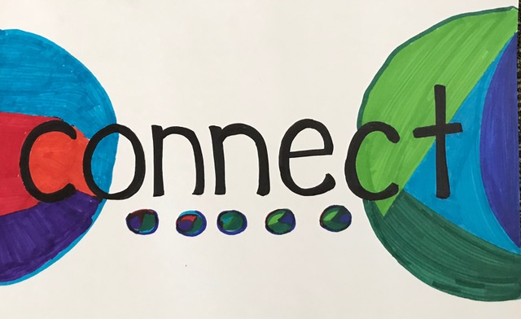

Slide 35
www.democracyprojectoftransylvania.org
www.facebook.com/democracyprojecttransylvania

